Slide 1
rev.health
Give doctors their nights back.
Get the practice paid right.
SEED · $5M · 2026
Patrick Feeney · Jeff Hughes · Daniel Dow, M.D. · founders@rev.health

Slide 2
THE PROBLEM
Independent practices are squeezed
1
2
3
2–3 hrs
5–10%
70%
of charting every night
of revenue lost to denials
of billing time on rework
Built and priced for big groups — incumbents run ~$999/provider/mo,
so the 1–5 doctor practice gets left behind.
rev.health — confidential
1

Slide 3
THE SOLUTION
One AI platform that runs the practice
Chart it. Schedule it. Get paid for it.
Note done before the doctor leaves the room. · target ≥98% first-pass clean claims.
10 modules in one system. · 2–3 hrs of nightly charting → ~0.
rev.health — confidential
2

Slide 4
WHAT WE DO BEST · 1
✎
The AI writes the note
Doctors get their nights back — 25–30 patients a day, no after-hours charting.
The secret: the AI answers a fixed set of clinical questions — it never writes from scratch.
Hallucination-free
Every answer is right, or it’s flagged — the clinician sees which.
~90% less cost
Bounded Q&A runs on small, cheap models — not one giant generative model.
Works every time
Same structure every visit — any patient, any case.
rev.health — confidential
3

Slide 5
WHAT WE DO BEST · 2
$
No biller needed
Billing is built in and AI-run. The practice gets paid right the first time.
rev.health — confidential
4

Slide 6
WHAT WE DO BEST · 3
Run leaner
~36%
100%
lower non-billing staff cost — AI does the admin
billing staff cost gone — no biller, RCM built in
Fewer people to run the office — the software does the admin, and billing is built in.
rev.health — confidential
5

Slide 7
MARKET
Nobody owns this market
The #1 EMR has just ~20% share.
30+ small EMRs split the rest — none over 3%, and none built for the 1–5 doctor practice.
$16.4B TAM
~$4B SAM · 60K practices
$50.9M SOM · 346 practices · ~1.3% of SAM
Source: Definitive Healthcare, Oct 2025.
rev.health — confidential
6

Slide 8
COMPETITION
Everyone else costs more — and still makes you hire a biller.
REV.health
athenahealth
eClinicalWorks
NextGen
Elation
SaaS $/prov/mo
$595
~$999 all-in
$449–599
quote+$125
$300–450
RCM rate
4.9%
7–10%
2.9%
separate
none
Value (all-in)
Integrated RCM
No biller needed
AI-native
Easy onboarding
Their all-in runs ~$999/mo + 7–10% of collections — and you still hire your own biller. REV doesn’t.
rev.health — confidential
7

Slide 9
WHY THEY’LL SWITCH
Doctors don’t love their EMR
27.2%
very satisfied
46.5%
neutral / somewhat
26.3%
dissatisfied
Only ~1 in 4 doctors is very satisfied — and a near-equal share is unhappy.
SUS 45.9 · “F”
EHR usability — bottom ~9% of all software
2 hrs : 1
desk/EHR work for every hour with patients
86 min
after-hours charting at home, every night
The burden — not the brand — is why they leave. REV removes it.
JAMA Network Open / ABFM 2024 · Mayo Clinic Proceedings 2019 · Annals of Medicine 2016–17 · KLAS Arch Collaborative.
rev.health — confidential
8

Slide 10
WHERE WE PLAY
We start where nobody else will
866,460
U.S. physicians in direct patient care
≈363,000 · 42%
in independent, physician-owned practices — down from 60% in 2012
≈180,000
in 1–4 doctor practices · OUR WEDGE
Large, shrinking, and ignored — independent doctors need this now.
Source: AMA 2024 Physician Practice Benchmark Survey; Fierce Healthcare; Becker’s ASC Review.
rev.health — confidential
9

Slide 11
THE MOAT
The patient owns the record
One portable chart
Stickier every visit
Network effect
The patient owns their record; practices connect to it. Switch practices and the chart comes too — no re-entry.
Each practice adds to one longitudinal record. Leaving means leaving the most complete version of the chart behind.
More practices on the network make each patient's record more useful — and the switching cost compounds.
Switching cost compounds with every visit.
rev.health — confidential
10

Slide 12
BUSINESS MODEL
Two revenue engines per provider
Software
Integrated billing
$595 /prov/mo
4.9% of collections
11% of revenue · $5.5M/yr
89% of revenue · $45.4M/yr
~$58.8K
~$147K
78%
65%
rev / provider / yr
ACV / practice
contribution margin
EBITDA at scale
rev.health — confidential
11

Slide 13
THE MODEL
Test a year, then explode
346
PRACTICES ON THE PLATFORM
$50.9M
exit ARR · 2031
$33.1M
145
EBITDA · 65% margin
61
11
25
866
2
2026
2027
2028
2029
2030
2031
providers at exit
2 → 346 practices over six years · 866 providers at exit.
≈ 1.3% of the SAM — about 1 in 80 independent practices.
rev.health — confidential
12

Slide 14
EXECUTION
From build to nationwide launch
2026
2027
2028
2029+
Build
First paying practices
Certified launch
Scale
Build the platform and start certification.
Design-partner clinics go live and start paying.
Certified — and selling nationwide.
Grow the practice base; add specialties.
rev.health — confidential
13

Slide 15
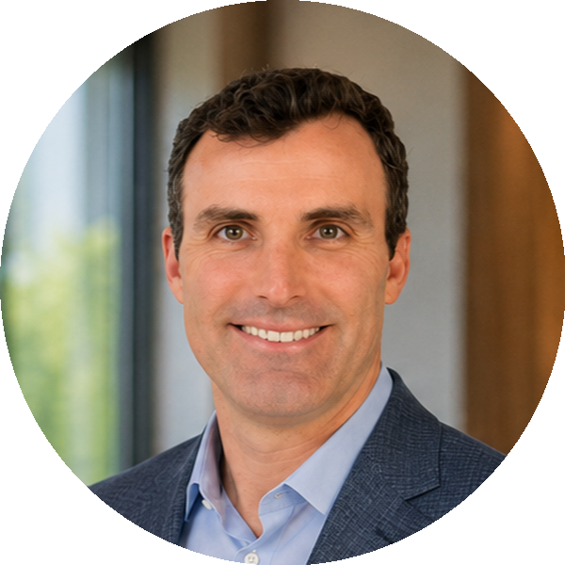

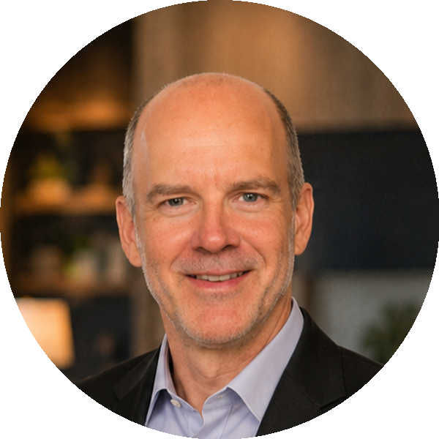
TEAM
The buyer. The builder. The doctor.
Patrick Feeney
Jeff Hughes
Daniel Dow, M.D.
CEO
CTO
Clinical
Runs a series of independent physician practices — the buyer REV is built for.
25+ years in enterprise software
Built EMR, RCM & PM
Former Citadel engineering leader
NASA Disruptive Technology Award
Practicing physician and investor. Columbia Business School.
Founders building this for their own practices.
rev.health — confidential
14

Slide 16
CAPITAL EFFICIENCY
$5M → 81× return
No Series A/B. The seed self-funds to exit.
$5M
$0
81.4×
one round to exit
follow-on dilution
MOIC · $5M→$407.2M
Even a conservative exit still returns 48.9×.
rev.health — confidential
15

Slide 17
THE ASK
$5M to launch
USE OF FUNDS
INVESTOR RETURN
• Product & engineering
• Get to launch
• Go-to-market
• Operations & reserve
$5M → $407.2M
81.4× MOIC · 2031 exit
80% held to exit — no dilution
48.9× conservative-case return
~6 yr hold
founders@rev.health
rev.health — confidential
16

Slide 18
WHY THIS WORKS
Every claim, one plain reason
More patients
We win small practices
AI writes the note in the room — no night charting.
Built and priced only for 1–5 doctors.
No biller
$5M is enough
Billing is built in and AI-run.
Self-funds to exit — no Series A/B.
36% leaner
81× return
The software does the admin work.
Keep 80% to a 10× exit.
rev.health — confidential
17

